Slide 1
Dried Beans Multiclassifiers
Craig Pennington
craig.pennington@colorado.edu
University of Colorado Boulder
Boulder, Colorado, USA

Slide 2
Dataset
Dry Bean Dataset. (2020). UCI Machine Learning Repository. https://doi.org/10.24432/C50S4B.
Multiclass classification of dry beans using computer vision and machine learning techniques By M. Koklu, Ilker Ali Özkan. 2020Published in Computers and Electronics in Agriculture

Slide 3
Introduction
In 2020, Koklu and Özkan published the paper cited above describing the use of a machine vision setup to extract features from images of seven different varieties of dried beans, and the use of these features in building four classifier models. They then evaluated the accuracy of those models.
In this project, I looked at the derived features dataset, and used it to build two additional models in order to compare my results to theirs.
The source code for this project can be found at: https://github.com/pennica/driedbeans/

Slide 4
Feature Table From the dataset metadata
Feature | Type | Description
Area | Integer | The area of a bean zone and the number of pixels within its boundaries
Perimeter | Continuous | Bean circumference is defined as the length of its border.
MajorAxisLength | Continuous | The distance between the ends of the longest line that can be drawn from a bean
MinorAxisLength | Continuous | The longest line that can be drawn from the bean while standing perpendicular to the main axis
AspectRatio | Continuous | Defines the relationship between MajorAxisLength and MinorAxisLength
Eccentricity | Continuous | Eccentricity of the ellipse having the same moments as the region
ConvexArea | Integer | Number of pixels in the smallest convex polygon that can contain the area of a bean seed
EquivDiameter | Continuous | Equivalent diameter: The diameter of a circle having the same area as a bean seed area
Extent | Continuous | The ratio of the pixels in the bounding box to the bean area
Solidity | Continuous | Also known as convexity. The ratio of the pixels in the convex shell to those found in beans.

Slide 5
Exploring the Data

Slide 6
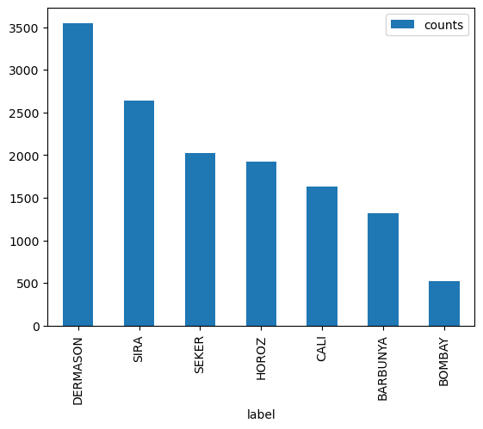
Record counts by bean type

Slide 7
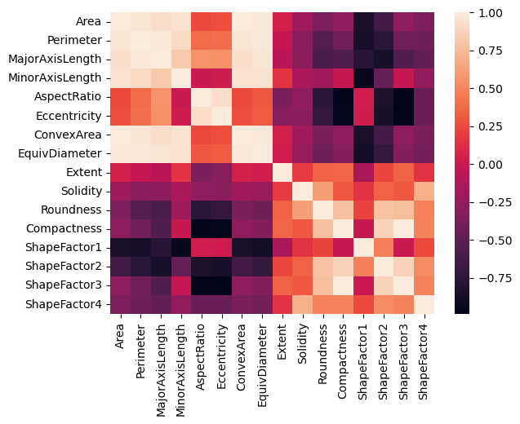
Correlation Heatmap

Slide 8
Building a model
KNN

Slide 9
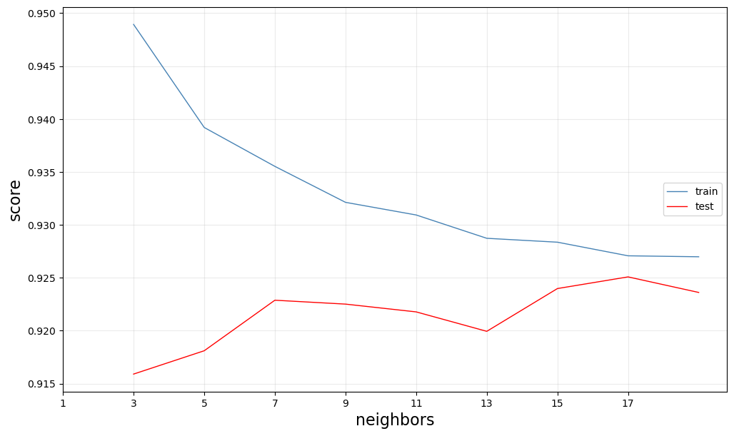
Accuracy by number of neighbors

Slide 10
Building a model 2
Random Forest

Slide 11
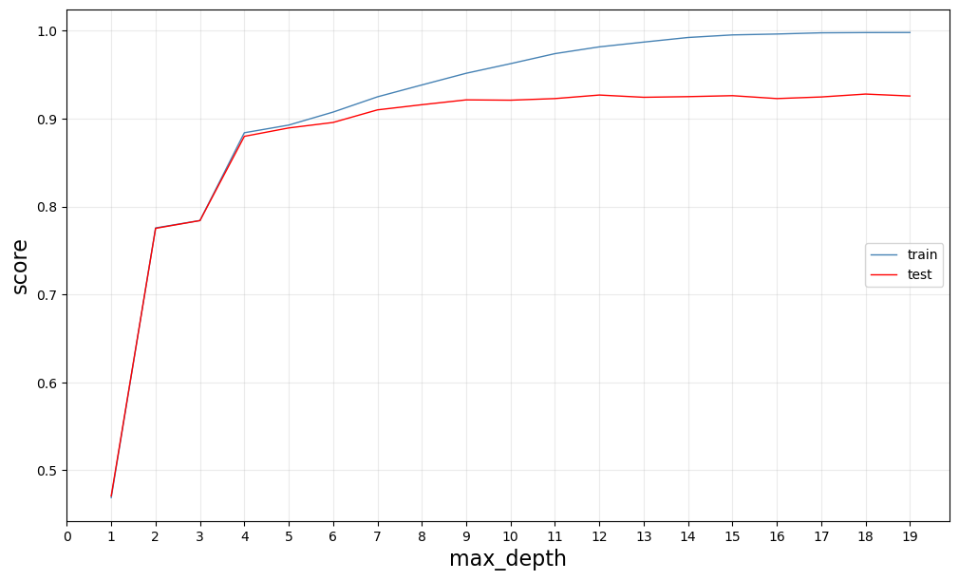
Accuracy by maximum depth

Slide 12
Final Models
KNN: K=17
Koklu and Özkan chose K=10 for their KNN model. I preferred an odd K to avoid ties. I chose 17 because it was where the test accuracy was closest to the train accuracy
Random Forest: Max Depth=9
Koklu and Özkan did not evaluate a Random Forest. In my evaluation, the test accuracy plateaued about here.
Feature selection
I did normalize the features for the KNN model. I ran out of time, but I would have liked to have done more exploration with these features.

Slide 13
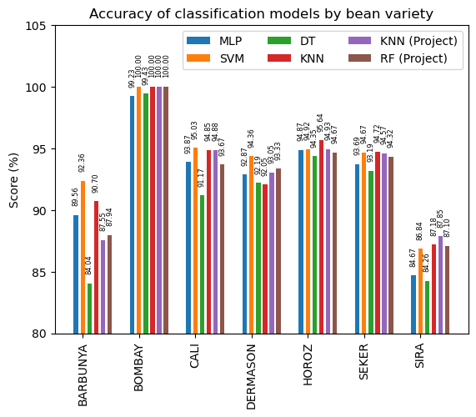
Accuracy of models by bean variety For the four models from the paper and the two from my project

Slide 14
Conclusions
I thought that there looked like a lot of correlation between features from the heatmap, so I thought that the random forest classifier, since it uses feature reduction, would do better than it did.
My two models performed consistently with the four models from the paper.
I used test_train_split rather than cross validation, so looking at their scores versus my scores are comparing apples to the specific apple variety that I had handy. I should have used cross validation as well.

Slide 15
References
Email: craig.pennington@colorado.edu
Github: https://github.com/pennica/driedbeans/
Dataset: Dry Bean Dataset. (2020). UCI Machine Learning Repository. https://doi.org/10.24432/C50S4B.
Reference Paper: Murat Koklu, Ilker Ali Ozkan, Multiclass classification of dry beans using computer vision and machine learning techniques, Computers and Electronics in Agriculture, Volume 174, 2020, 105507, ISSN 0168-1699, https://doi.org/10.1016/j.compag.2020.105507.

